Slide 1

Face Mask detection model
By Andrés Zamora

Slide 2

Index - The project - The data - The model - Training results - Cloud Storage - Potential improvements

Slide 3
The project
The motivation behind the project was to create a face mask detection model for businesses to be able to detect whether customer.s or employees were wearing their facemasks or not

Slide 4
The Data
1380 jpg images were scraped from a generative adversarial network found in thispersondoesnotexist.com using shell script
Half of them (690) were augmented by placing png’s of white blue and black facemask on top of them using the application called picmonkey.com
this data was then put into folder of images with and without face masks respectively and fed to the model for training

Slide 5

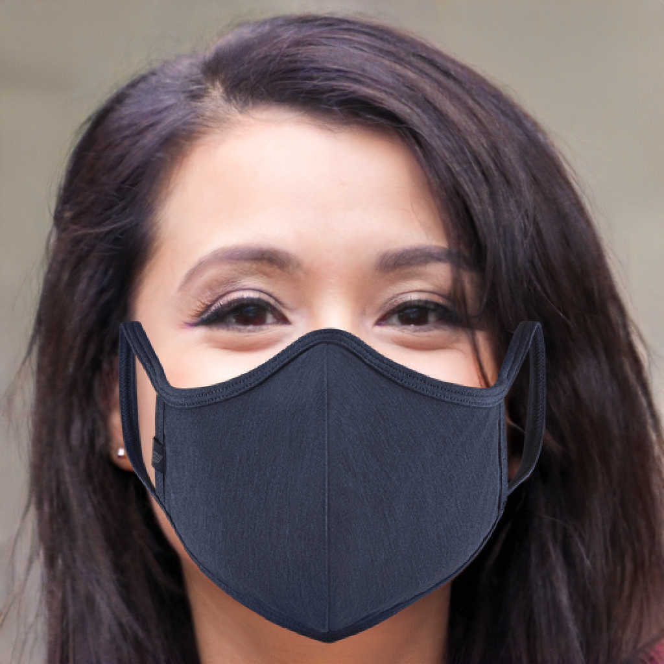

Slide 6
The model
Imagenet V2 was used for face detection without a fully connected layer and the head model to be used for face mask detection was placed on top of this model
The head model consisted of a CNN model from keras with a pooling layer, a flatten layer, a dense layer with dropout and a softmax layer
The batch size was 64 images with 32 epoch, the solver used was Adam

Slide 7
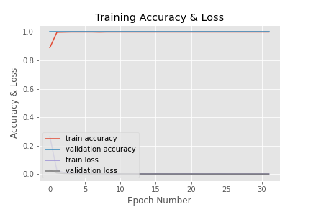
Training Results
The training went very well

Slide 8
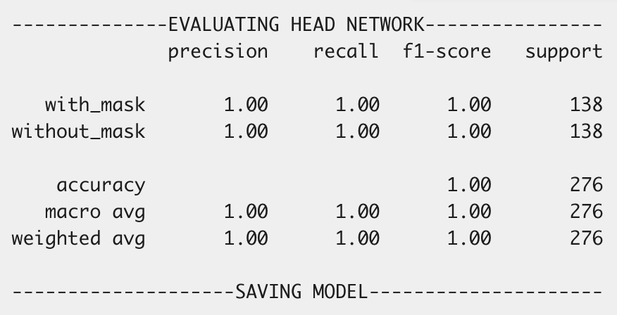

Slide 9
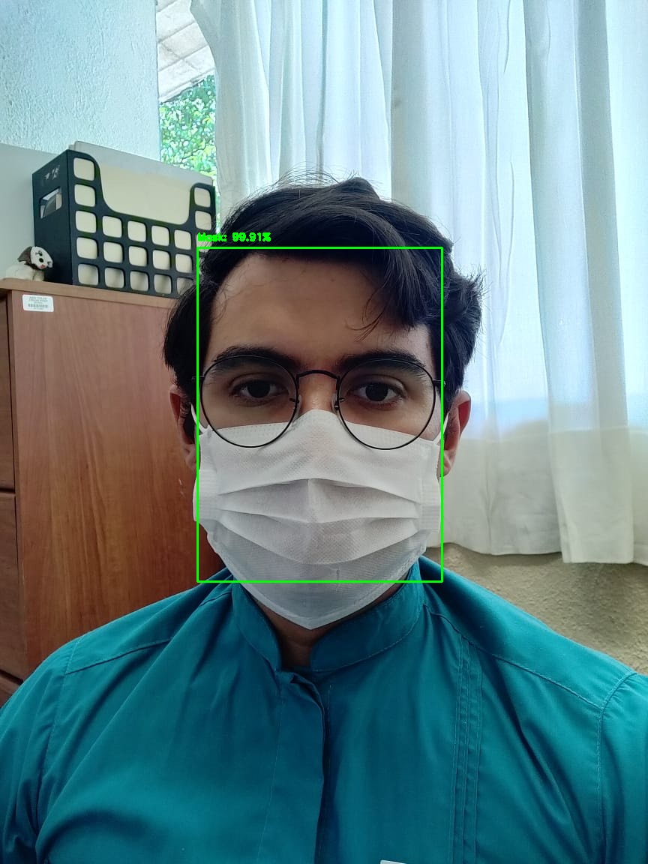
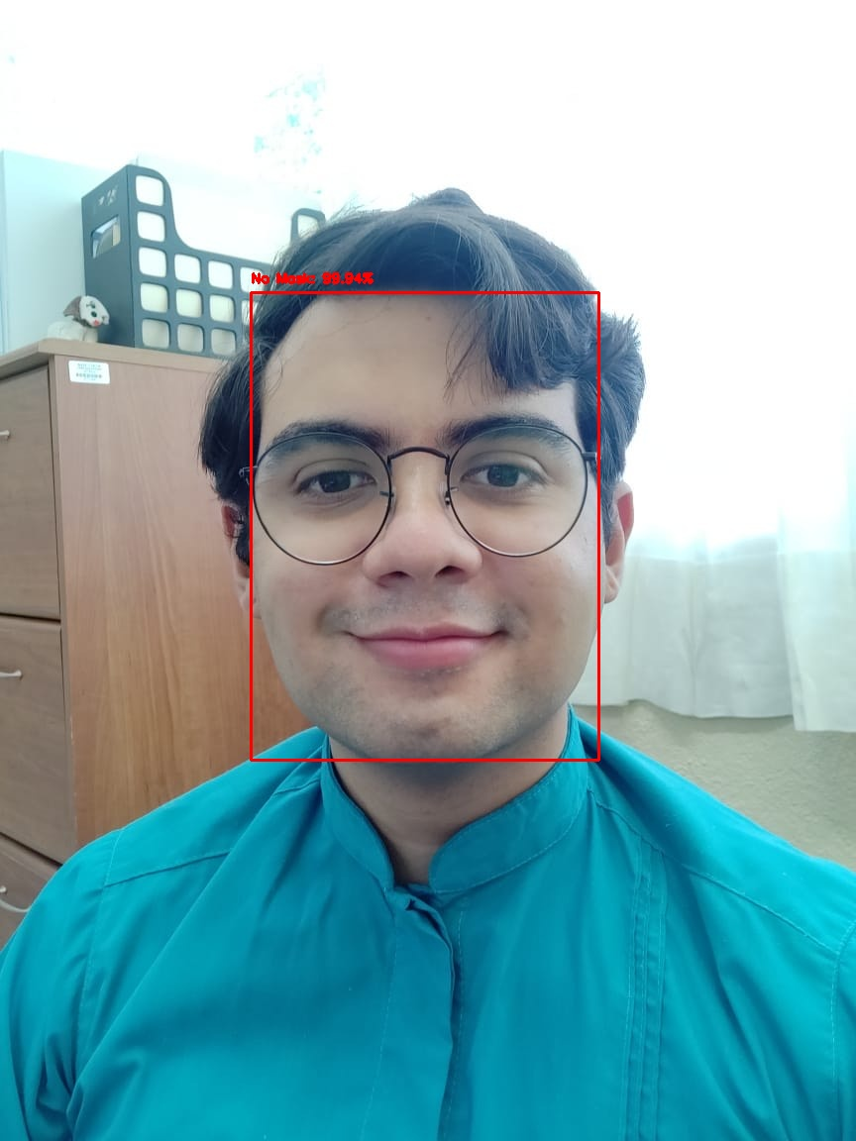

Slide 10
Storage in the Cloud
For cloud storage a docker container with opencv in the TX2 is used to take pictures send it to a bridge alpine container that forwards it to the v100 ibmcloud VSI of flavor AC2_8X60X100
Once the VSI receives the images it classifies them on whether they have people with facemasks or not and send the ones without a face mask to the cloud storage to track who is not wearing a facemask

Slide 11
Room for impovements
Look for ways to increase the frame rate
Place pictures with several people in them with and without facemasks to train the model
Include more patters of face masks because so far only white blue and black face masks were included, so if different patterns of facemasks are shown this could confuse the model

Slide 12
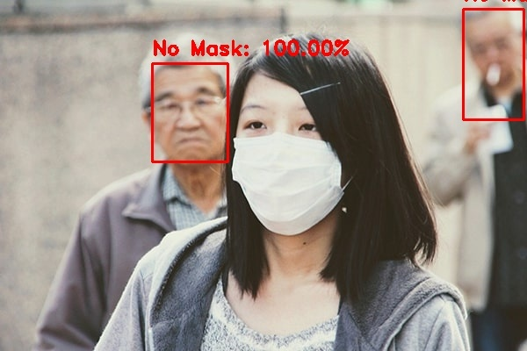

Slide 13
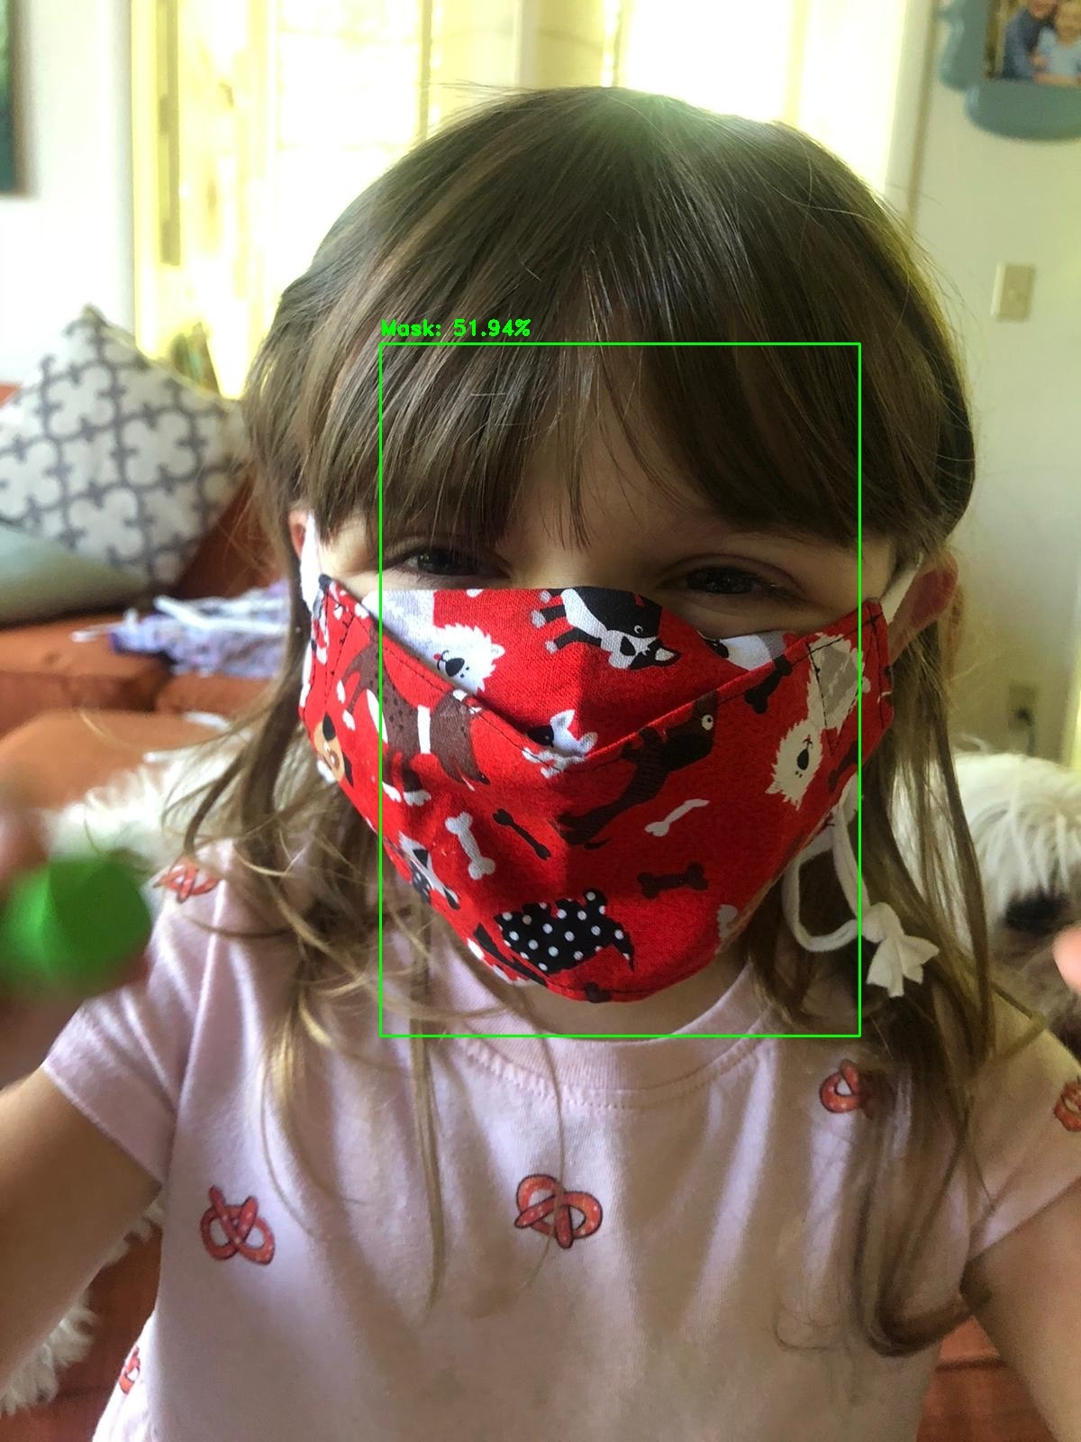

Slide 14
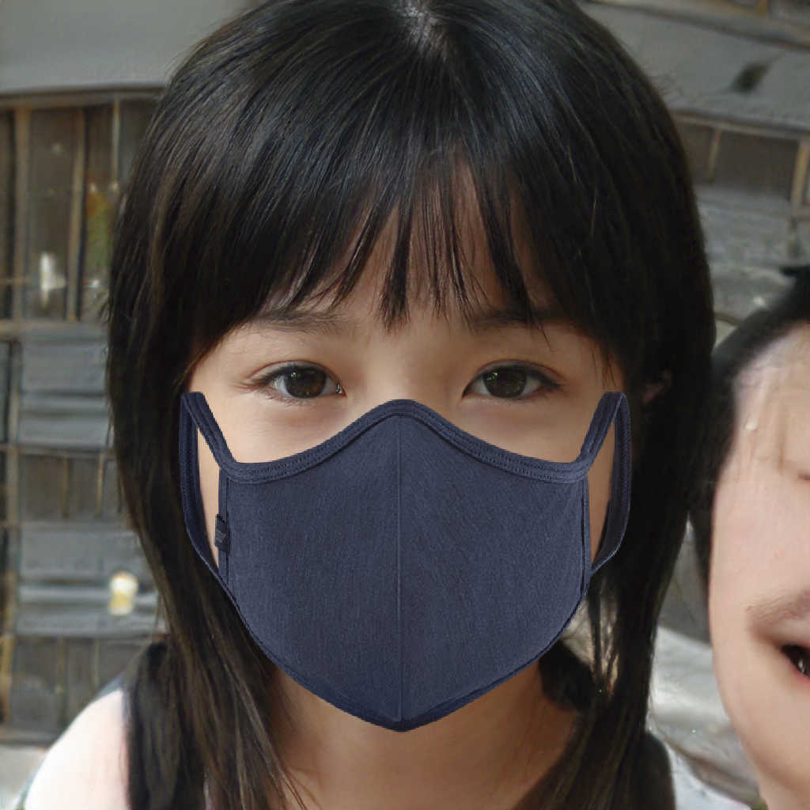

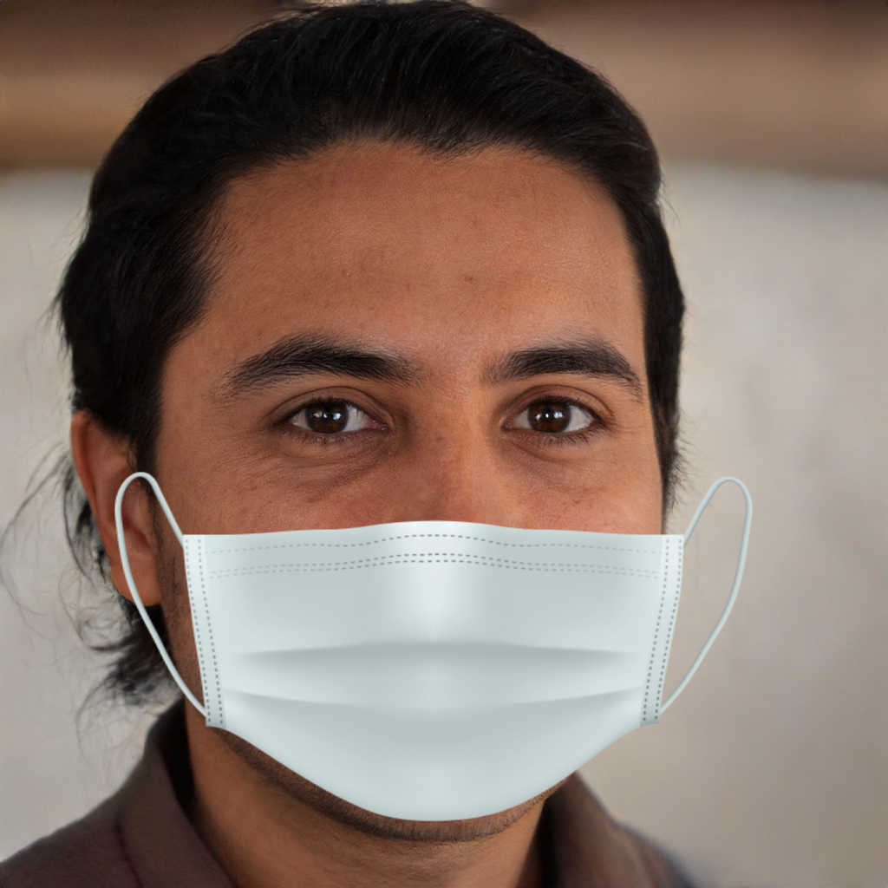
Thank you

